Slide 1
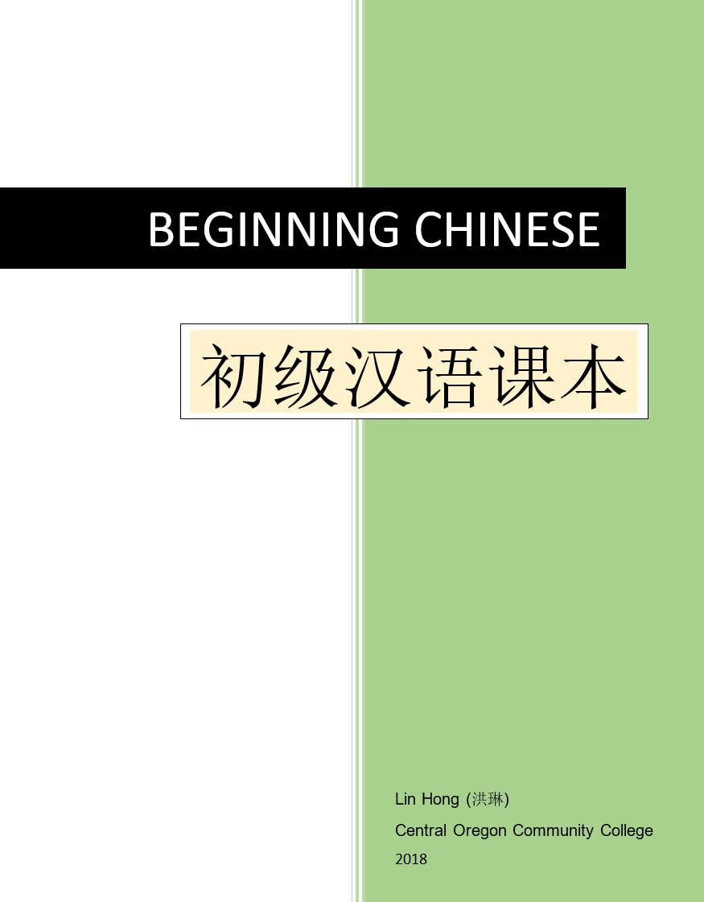
Pre-Unit 2
OER Beginning Chinese Textbook
By Lin Hong

Slide 2
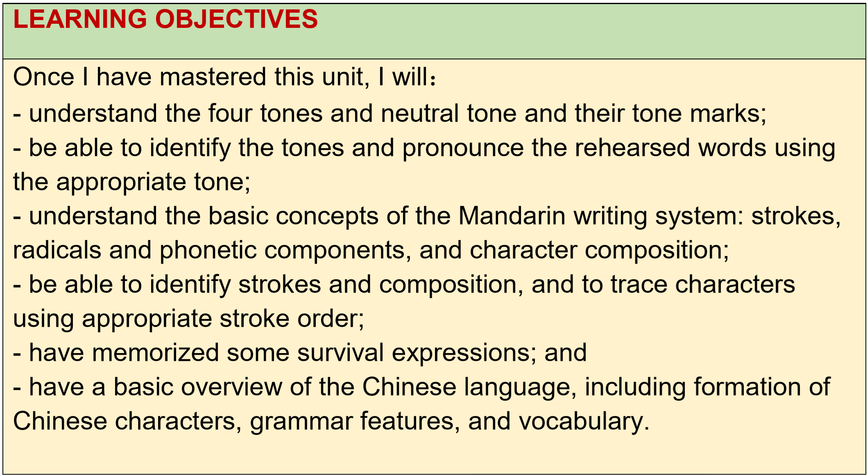

Slide 3
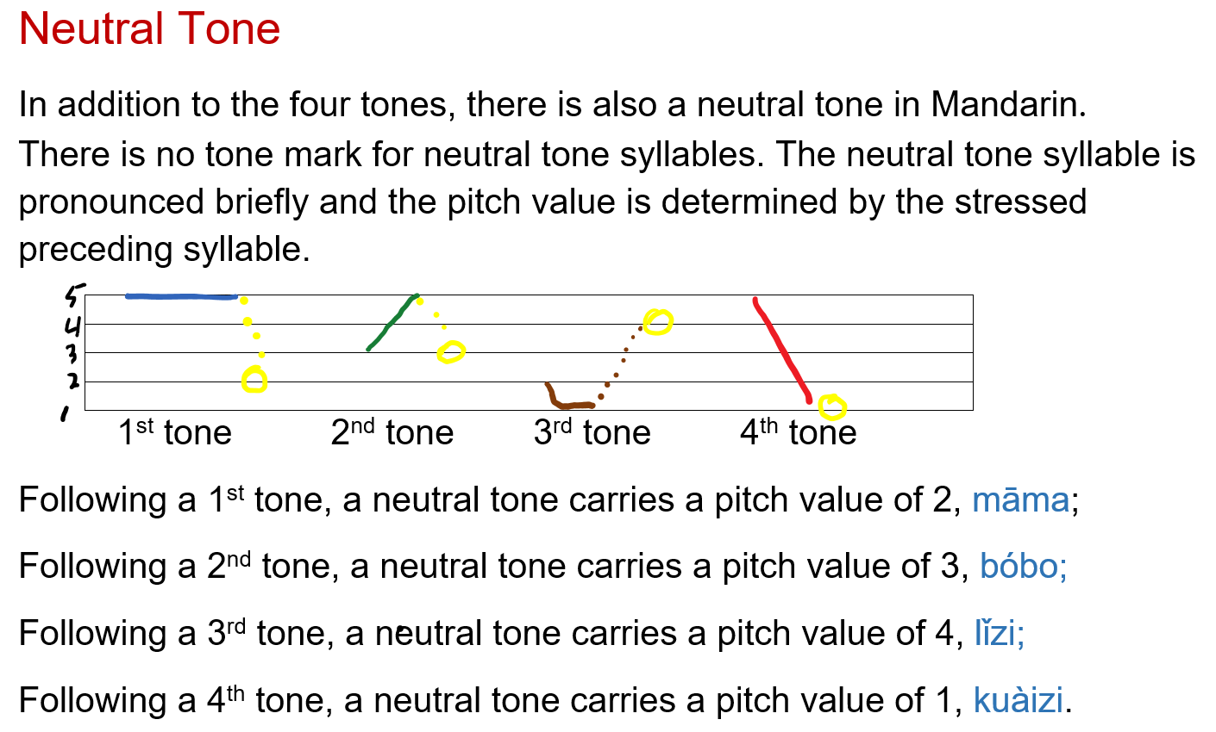
Mandarin Phonology (Sound System) II

Slide 4
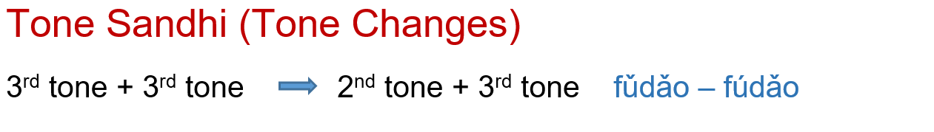
Mandarin Phonology (Sound System) II

Slide 5
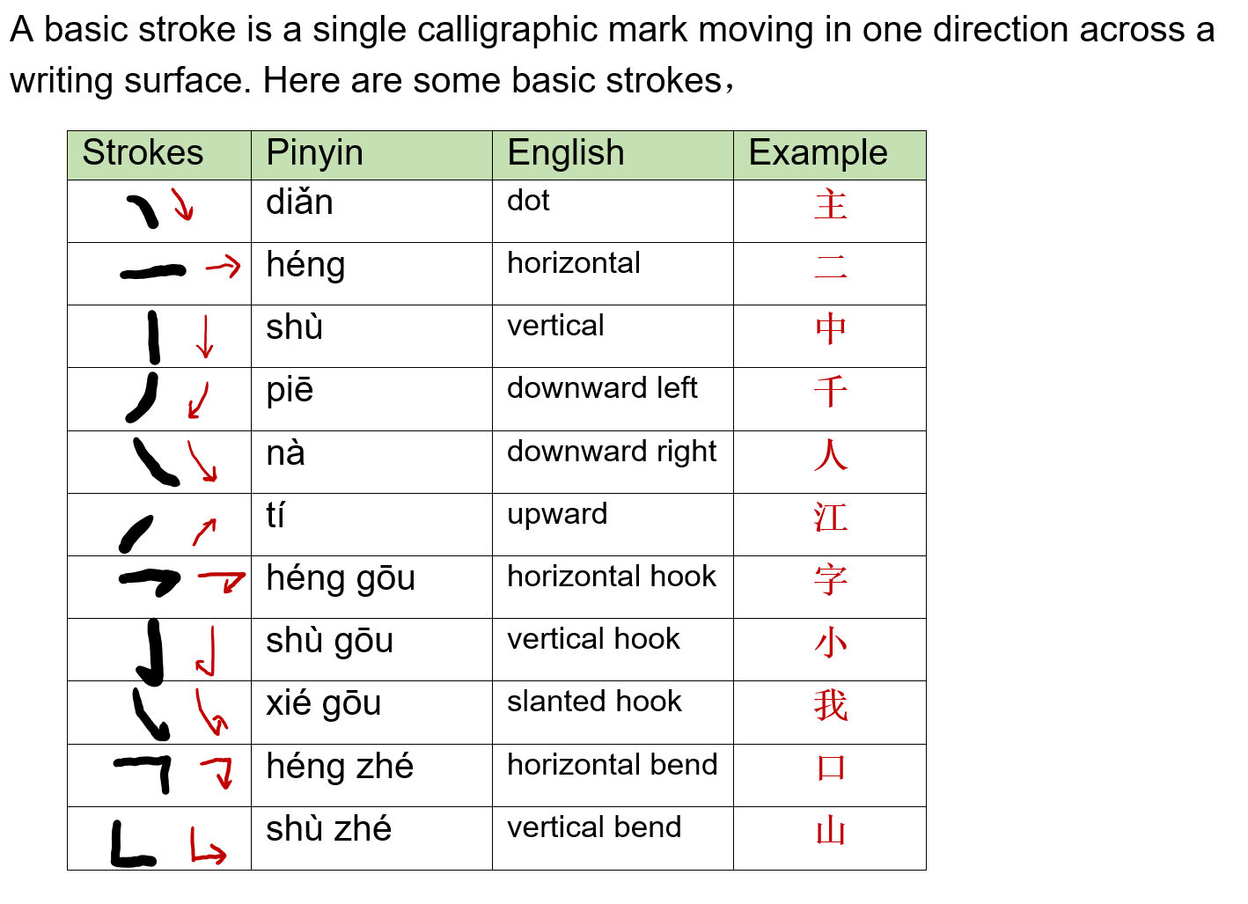
Chinese Writing System

Slide 6
Chinese Writing System (Cont.)
The word “radical” in Chinese 部首 (bùshǒu) literally means "section header." Traditionally Chinese characters are grouped according to their radicals in a Chinese dictionary. These radicals are often also semantic indicators that tell the meanings of the characters. Even though in some cases the original semantic connection has become obscure over time, it is a very efficient way to learn characters if you learn a good amount of basic radicals.
Here is: A View of Radicals
(https://www.gotcharacters.com/wp/a-radical-view/)

Slide 7
Chinese Writing System (Cont.)
Phonetic Components
A phonetic component gives the pronunciation of a Chinese character. Almost 80% of modern Chinese characters are pictophonetic characters, with one semantic indicator (radical) and one phonetic component. For instance, the phonetic component 青 (qīng) indicates the pronunciations of 请（qǐng）/晴（qíng）/清（qīng）/情（qíng）. Usually the right side of a pictophonetic character is the phonetic component, and the left side is the semantic indicator (radical).

Slide 8
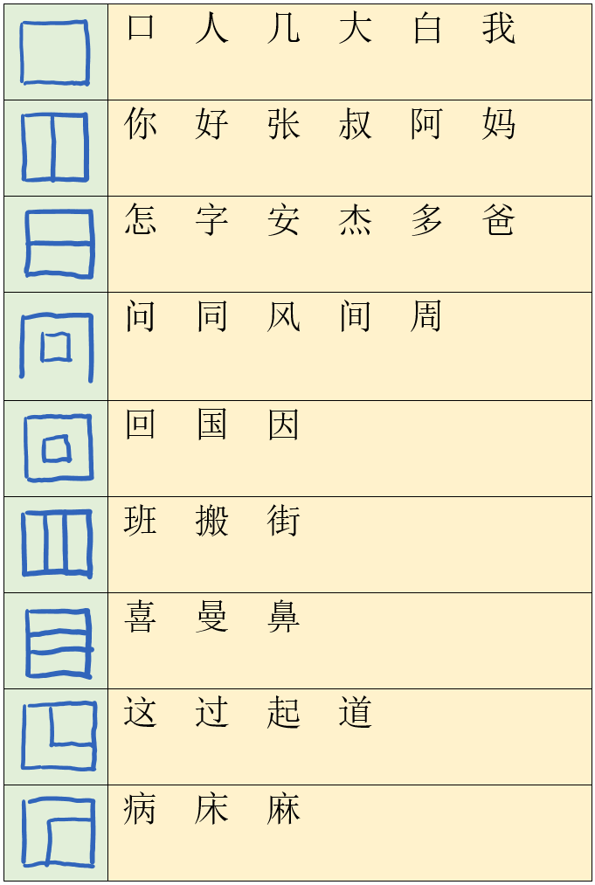
Chinese Writing System (Cont.)
Character Composition
There are 9 kinds of common compositions of characters. By knowing the composition of characters, you will find it becomes easier to memorize characters by some components than by individual strokes. There are some less common compositions that are not included here.

Slide 9
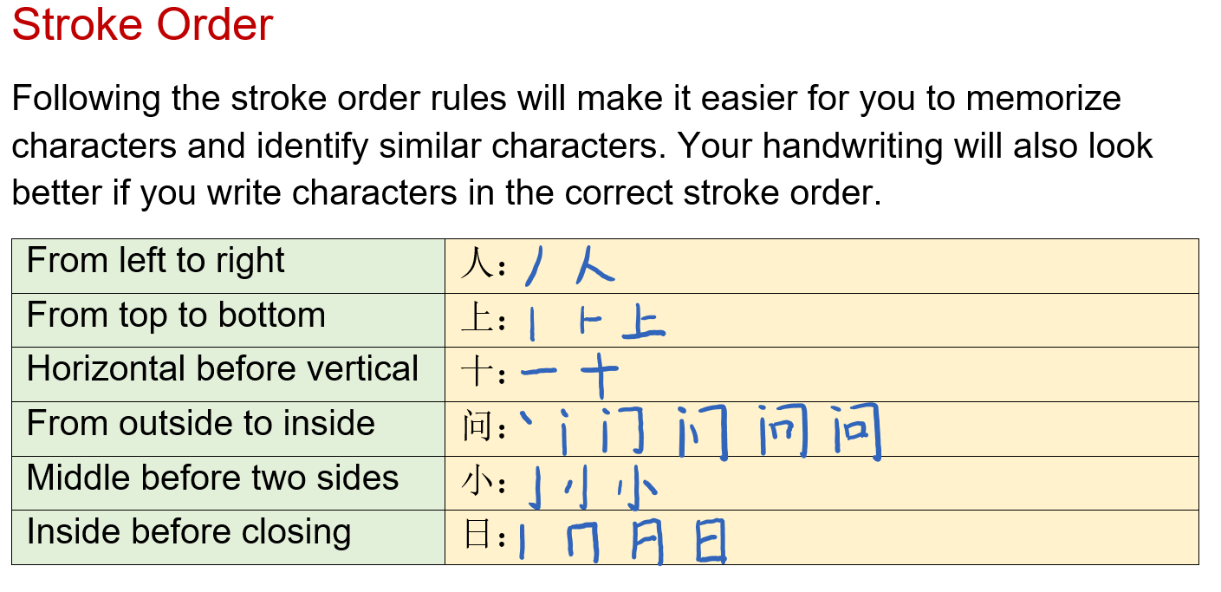
Chinese Writing System (Cont.)

Slide 10
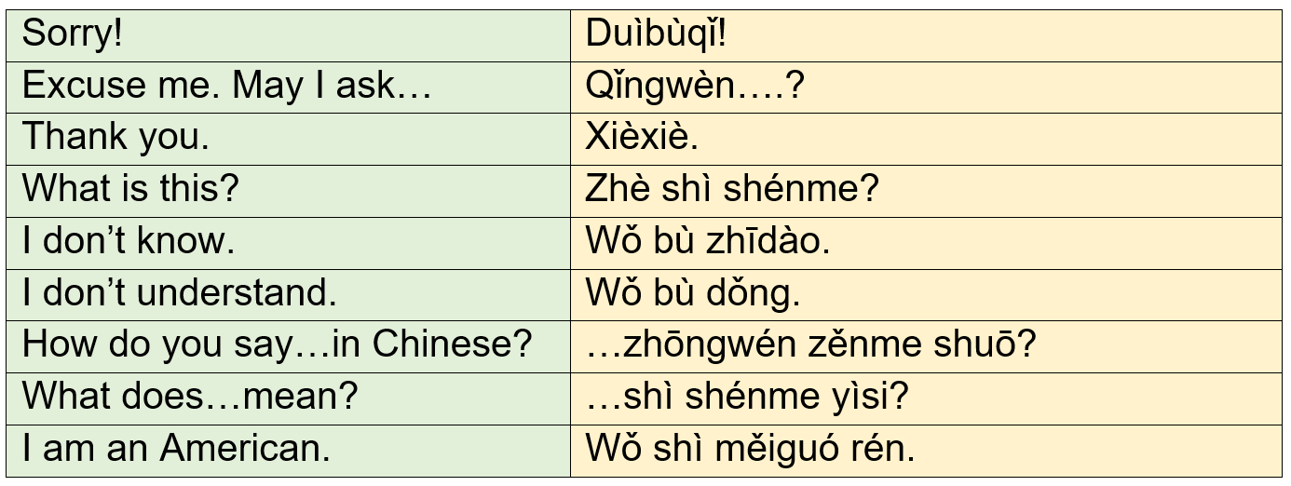

Survival Expressions

Slide 11
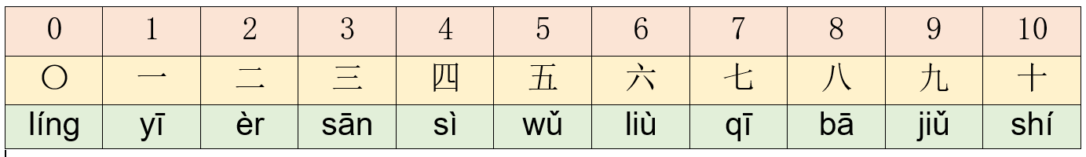
Numbers

Slide 12
Overview of the Chinese Language II
Formation of Chinese Characters
A common claim that Chinese writing is pictographic and each character represents a picture is not really true. Only a small amount of ancient characters evolved from pictures. The majority of modern Chinese characters are pictophonetic characters consisting of a semantic radical and a phonetic component.
Chinese characters can be divided into six categories based on the manner in which they are formed or derived. Example:

Slide 13
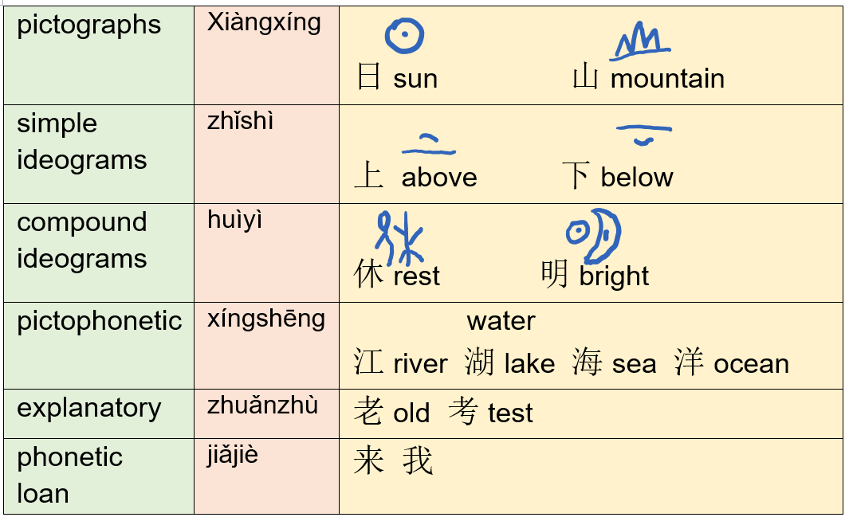
Overview of the Chinese Language II(Cont.)

Slide 14
Overview of the Chinese Language II(Cont.)
Grammar Features
Here are some characteristics of Mandarin Chinese:
1. Topic + Comment sentence structure.
Subject + Verb + Object
I have only a few friends.
Topic + Comment
我的朋友 很少。
(lit. “My friends are few.”)

Slide 15
Overview of the Chinese Language II(Cont.)
Grammar Features (Cont.)
2. Verbs have aspect rather than tense.
Mandarin Chinese adopts function words to express whether the action of the verb is “continuous” or “completed,” or to indicate if it has ever been experienced before. To express tense, a time phrase will be inserted in the sentence before or after the verb depending on the context.
3. Measure words (classifiers) are used between number words/specifiers and nouns. For instance:
Number + Measure + Noun
Yī gè rén
一 个 人
(lit. A person)

Slide 16
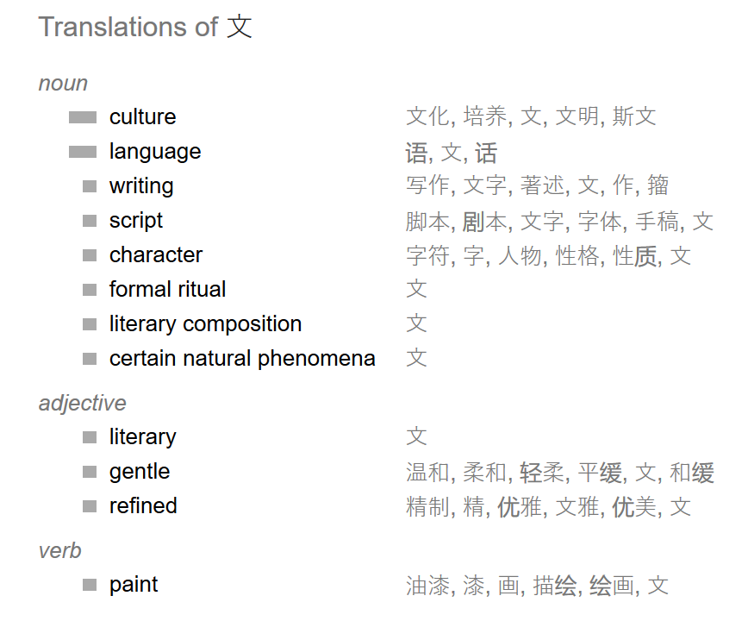
Overview of the Chinese Language II(Cont.)
Vocabulary
In general, one character records one syllable, but one character often carries multiple meanings, related or unrelated.

Slide 17
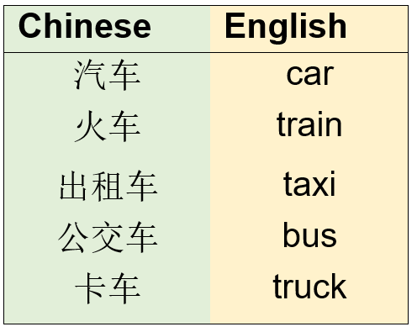
Overview of the Chinese Language II(Cont.)
Vocabulary(Cont.)
Two-syllable words predominate in Mandarin Chinese. The meaning of a two-syllable word is usually the combination of the meanings of each character/syllable.

